Slide 1





MARKETING
STRATEGY
TEMPLATE
Build a focused strategy in under 30 minutes. Launching a startup or scaling a business, create a roadmap without an expensive consultant.

Slide 2
01 / BUSINESS OVERVIEW
Category | Strategic Detail
Company Name | [Insert Your Company Name]
Industry / Niche | [e.g., B2B SaaS, D2C E-commerce, Consulting]
Website | [www.yourdomain.com]
Mission Statement | [A brief statement detailing your purpose and core values]
Primary Goal | [The single most important objective for the next 12 months]

Slide 3

02 / TARGET AUDIENCE
Ideal Customer Profile [Describe your perfect buyer persona in one sentence]
Demographics Age: [Range], Location: [Region], Income: [Range]
Core Pain Points [What precise problem are they urgently trying to solve?]
Buying Behavior [How, when, and where do they typically make purchases?]
Decision Makers [Who ultimately holds the purchasing power?]

Slide 4

03 / MARKET ANALYSIS
Top Competitors [List the top 3 direct competitors in your market]
Competitive Advantages [What do you do significantly better than anyone else?]
Market Opportunities [Identify untapped niches or emerging industry trends]
Threats & Risks [Economic factors, changing regulations, or new entrants]

Slide 5


04 / BRAND POSITIONING
UNIQUE VALUE PROPOSITION
BRAND PERSONALITY
[The single most compelling reason why a customer should buy from you instead of your competition. Focus on outcomes.]
[If your brand were a person, how would they act? E.g., Professional, Authoritative, Approachable, Quirky, Innovative.]
KEY MESSAGING
ELEVATOR PITCH
[List 3-4 core messages that consistently resonate with your target audience's deepest pain points.]
["We help [Target Audience] achieve [Desired Result] by [Unique Solution / Methodology]."]

Slide 6
05 / MARKETING GOALS
Increase Leads Generate [X] qualified inbound leads per month.
Increase Sales Achieve [X]% growth in quarterly recurring revenue.
Increase Website Traffic Reach [X] unique targeted visitors monthly.
Improve Brand Awareness Grow total social media following and engagement by [X]%.
Customer Retention Reduce overall customer churn rate to under [X]%.

Slide 7
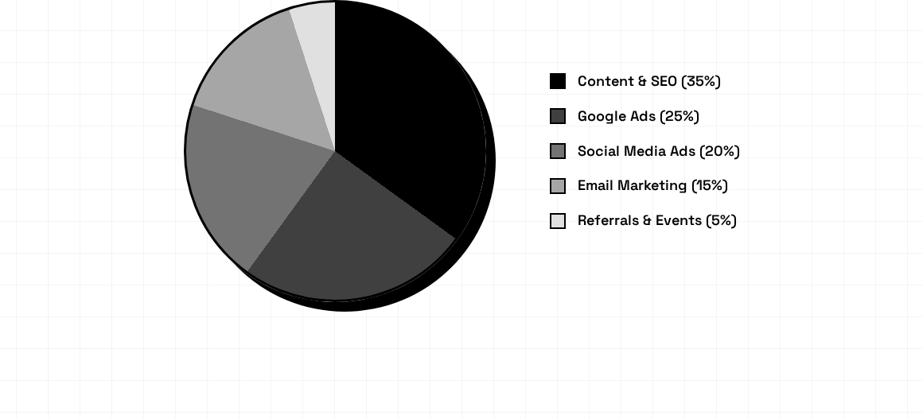
06 / MARKETING CHANNELS (BUDGET SPLIT)
Strategic allocation prioritizes foundational, long-term content assets (SEO) while maintaining aggressive paid acquisition funnels.

Slide 8
07 / MONTHLY BUDGET PLANNER
Category | Allocated Spend | Included Items / Notes
Advertising | $0.00 | Google Ads, Facebook Ads, LinkedIn Ads, Retargeting
Content | $0.00 | Blog writing, Video production, Copywriting, PR
Software | $0.00 | CRM, Email marketing tools, SEO analytics suites
Creative | $0.00 | Graphic design, Photography, Branding updates
Miscellaneous | $0.00 | Buffer for testing, event fees, contingency fund
TOTAL | $0.00 | Total Projected Monthly Marketing Spend

Slide 9
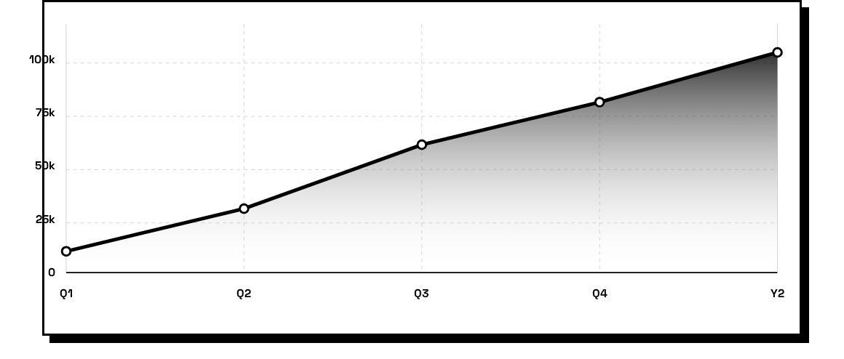
08 / KPI PROJECTIONS: REVENUE GROWTH
Primary KPIs to monitor: Website Traffic, Leads Generated, Conversion Rate, Cost Per Lead (CPL), Return on Ad Spend (ROAS), and Customer Acquisition Cost (CAC).

Slide 10
09 / 90-DAY ACTION PLAN
MONTH 2: LAUNCH
DAY 90+: SCALE
Execute initial outbound campaigns, publish foundational SEO content, and launch initial ad tests.
Systematize successful tactics, increase allocated budget on positive ROAS, and expand market reach.
MONTH 1: FOUNDATION
MONTH 3: OPTIMIZE
Audit current assets, finalize messaging, set up core analytics tracking, and clearly define the ICP.
Analyze incoming initial data, double down on winning channels, and optimize conversion rates.

Slide 11


BONUS / MARKETING PRIORITY MATRIX
QUICK WINS
LONG TERM PROJECTS
(High Impact, Low Effort)
(High Impact, High Effort)
Optimize Google Business Profile
Comprehensive technical SEO overhaul
Setup abandoned cart email sequences
Launch and sustain a weekly podcast
Launch retargeting ads to recent visitors
Develop a customer loyalty program
Update CTAs on top-performing pages
Build a comprehensive lead magnet hub

