Slide 1


NEVER WONDER WHAT
TO POST AGAIN
Plan an entire month of content in one place.
Minimalist Content Calendar Template

Slide 2


THE MASTER PLAN
STRATEGIC EXECUTION
Consolidate: Plan an entire month of content in a single, unified workspace.
Categorize: Distribute your messaging across predefined content pillars.
Execute: Track daily deliverables from ideation to final approval.
Measure: Review monthly metrics to optimize future campaigns.
Adapt: Apply lessons learned iteratively to grow your digital footprint.

Slide 3






CORE CONTENT CATEGORIES
EDUCATIONAL
BEHIND THE SCENES
SOCIAL PROOF
PROMOTIONAL
Share actionable tips, how-tos, FAQs, and industry news. Position your brand as an authority.
Build trust through customer stories, testimonials, and user-generated content (UGC).
Drive revenue with product showcases, special offers, event announcements, and hard CTAs.
Humanize your brand. Show the workspace, the team, and the daily processes behind your products.
OTHER CATEGORIES TO MIX IN: TIPS · FAQS · INDUSTRY NEWS · OFFERS · EVENTS

Slide 4
THE PLANNERS
Macro strategies to micro executions.

Slide 5
MONTHLY PLANNER (MACRO VIEW)
Week | Platform | Campaign / Theme | Primary Goal | Status
Week 1 | Instagram / TikTok | Product Launch Teasers | Brand Awareness & Reach | Completed
Week 2 | LinkedIn / Blog | Thought Leadership Series | Lead Generation (Ebook download) | In Progress
Week 3 | Email / Facebook | Customer Success Stories | Trust Building & Conversion | Planned
Week 4 | All Platforms | End of Month Flash Sale | Direct Sales / Revenue | Planned

Slide 6
DAILY PLANNER (MICRO EXECUTION)
Date | Platform | Category | Topic / Headline | Caption Draft | CTA | Hashtags | Creative | Approval
01-Oct | Instagram | Educate | 3 Ways to Boost Output | Struggling with productivity? Here are 3 frameworks we use daily... | Save Post | #Productivity | Ready | Yes
02-Oct | LinkedIn | Industry | Q3 Market Analysis | The data is in. Q3 showed a massive shift towards automation... | Read Blog | #TechTrends | Ready | Yes
03-Oct | TikTok | Behind Scenes | A day in the office | Pack orders with us! Volume is crazy today... | Follow Us | #SmallBiz | Editing | Pending
04-Oct | Email | Offer | Exclusive 24hr Sale | VIPs only: Take 20% off our best-selling templates... | Shop Now | N/A | Briefed | No
05-Oct | YouTube | Showcase | Full Product Walkthrough | Dive deep into the new features released this month... | Subscribe | #Tutorial | Filming | No

Slide 7
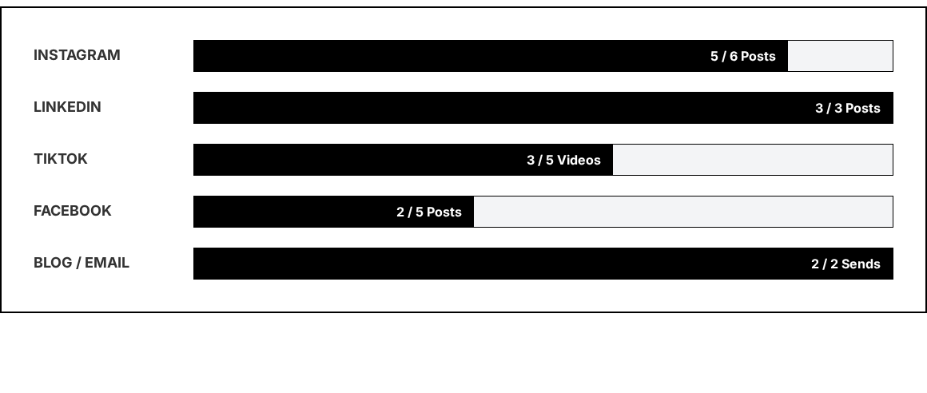
POSTING FREQUENCY TRACKER
Goal vs. Actuals Tracker: Visualizing consistency across platforms ensures you hit algorithmic thresholds and maintain audience presence.

Slide 8
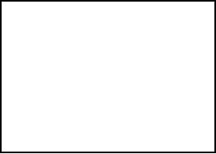
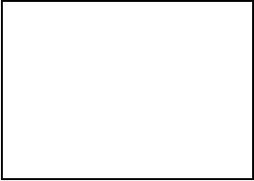
MONTHLY PERFORMANCE METRICS
124k
8.4%
1.2k
345
TOTAL REACH
ENGAGEMENT
LINK CLICKS
NEW LEADS
Audience Growth: +1,450 Followers Gained

Slide 9

QUALITATIVE MONTHLY REVIEW
POST ANALYSIS
LESSONS LEARNED & NEXT STEPS
Video content showing human faces outperformed graphic text posts by 3x.
Best Performing Post:
"Behind the Scenes: Office Setup" (IG Reel). High reach and saves.
Educational carousels generate the highest 'Save' rate.
Worst Performing Post:
"Industry News Text Graphic" (LinkedIn). Low dwell time, minimal comments.
Email open rates peaked on Tuesdays at 10 AM.
Action for next month: Shift 20% of graphic budget into short-form video production.

Slide 10
READY TO PLAN?
DUPLICATE THIS TEMPLATE AND BUILD YOUR MONTH.

